Slide 1

Can Money buy Happiness?
Data Science Research
By Zuowen Tang

Slide 2
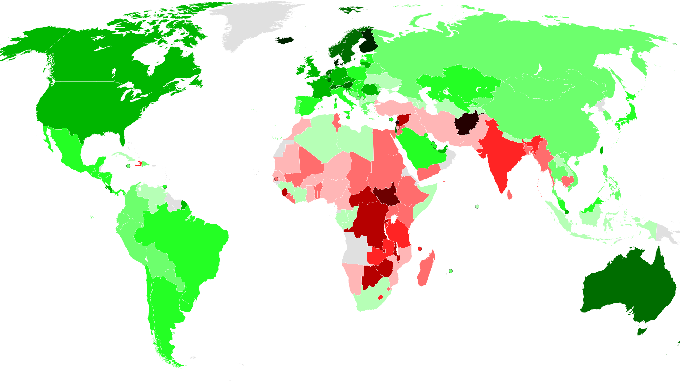
World Happiness Report

Slide 3
Explanation of Variables
GDP per Capita is an economic metric that breaks down a country's economic output per person.
Social Support, also known as family support in the past data set report, is more personal and subjective. It means how much emotional support a person can receive from their family/friends. This variable is rated by respondents based on their experience.
Healthy Life Expectancy means the average number of years that a person can expect to live in full health.

Slide 4
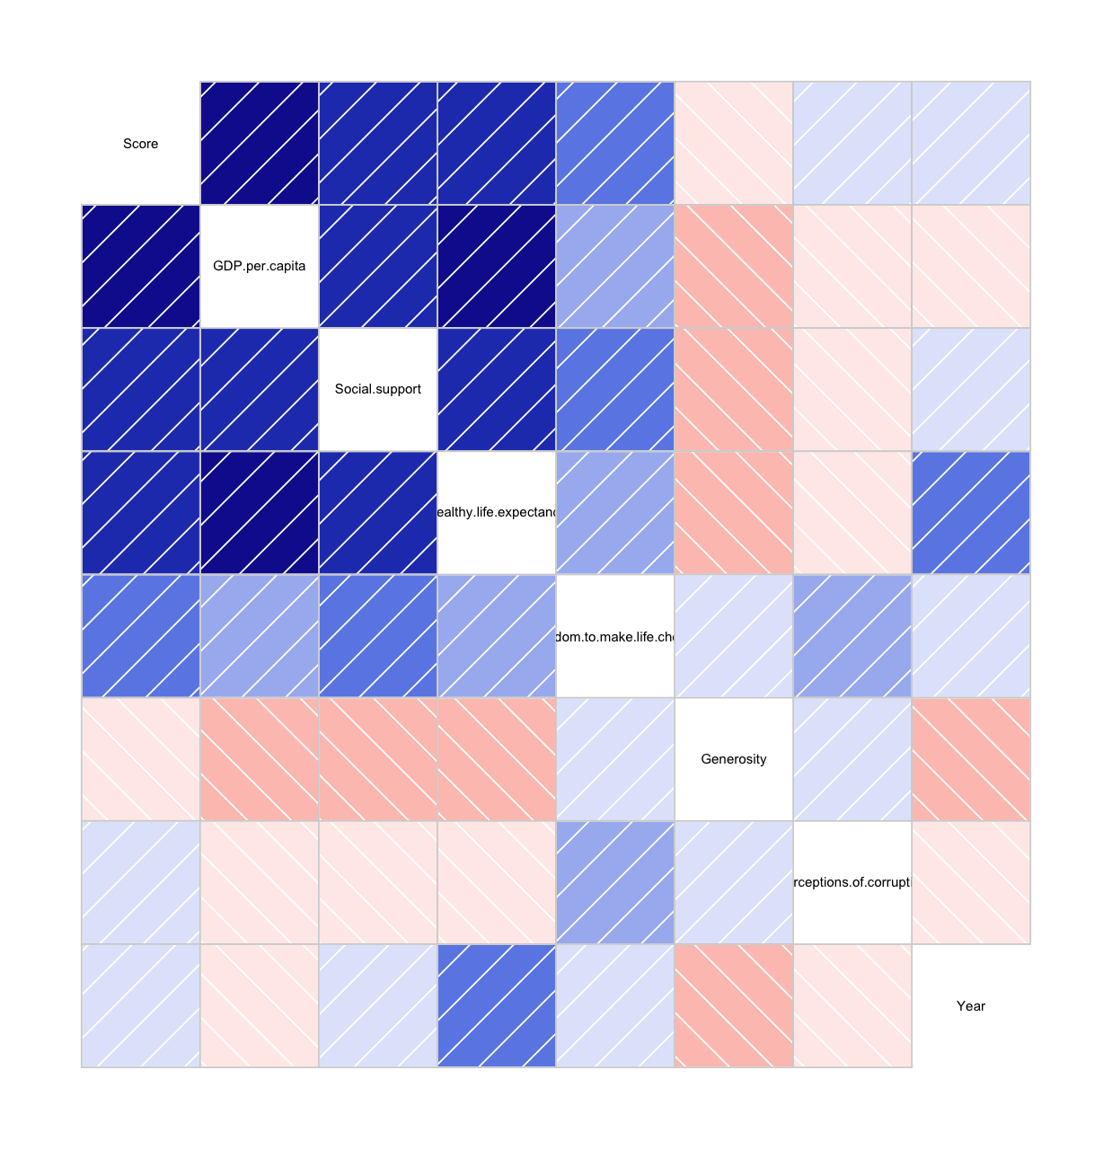
Correlation Diagram

Slide 5
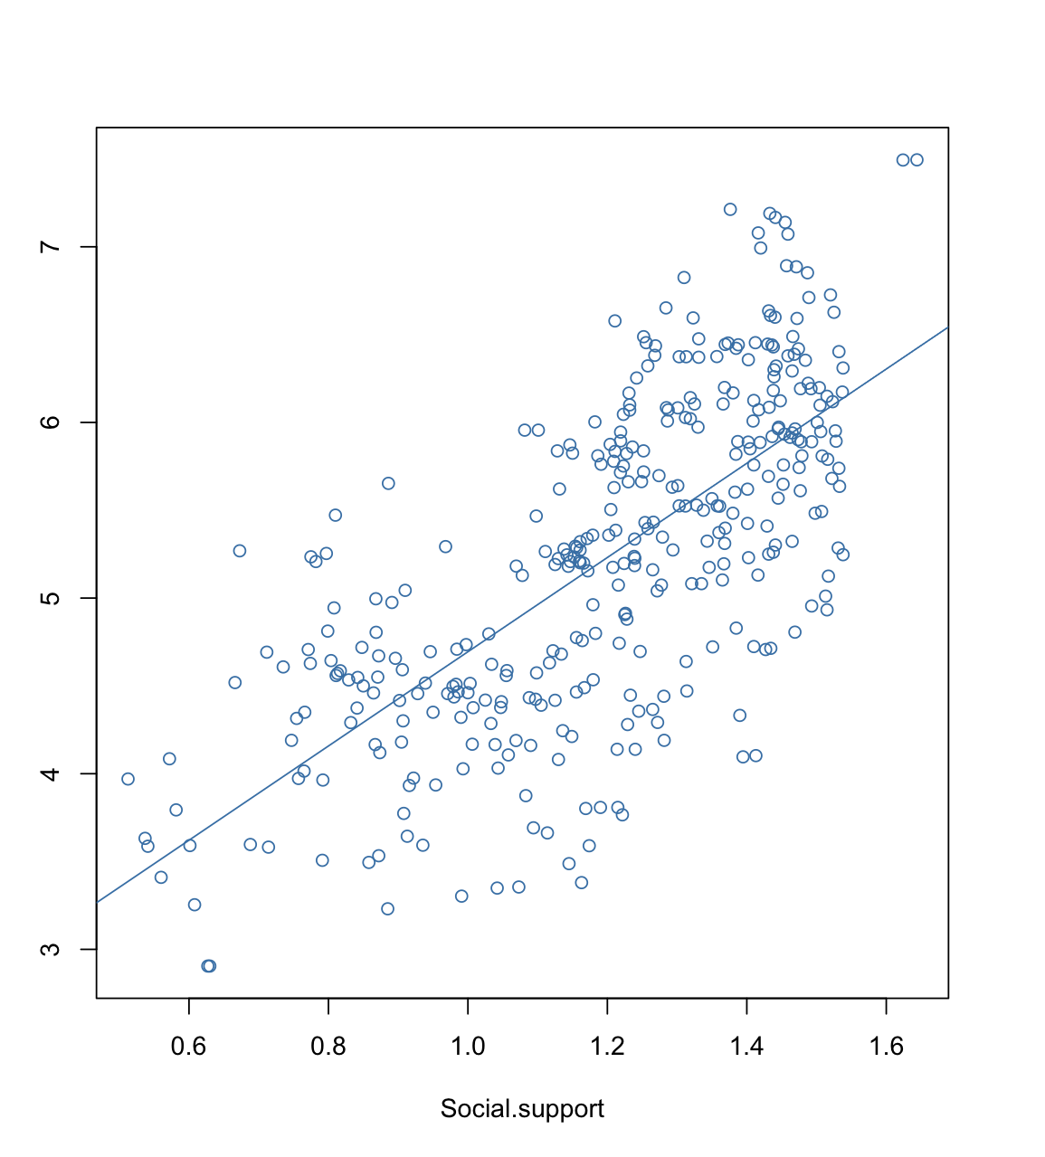
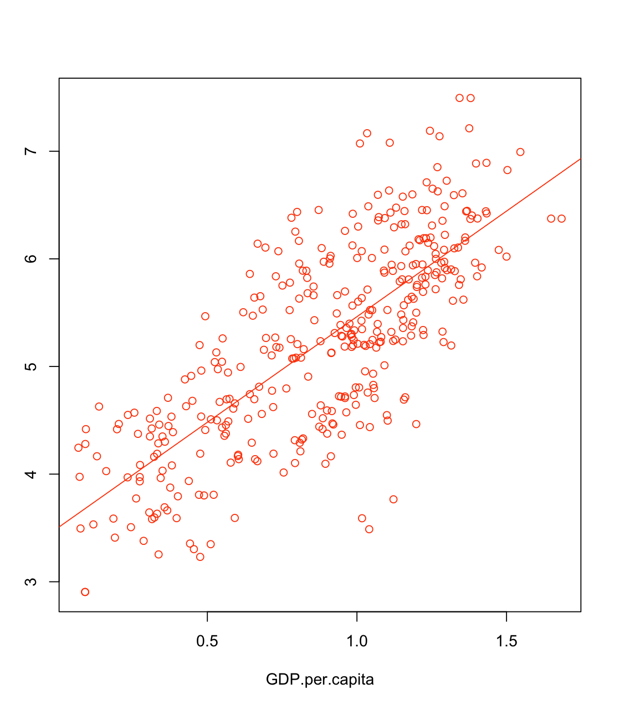
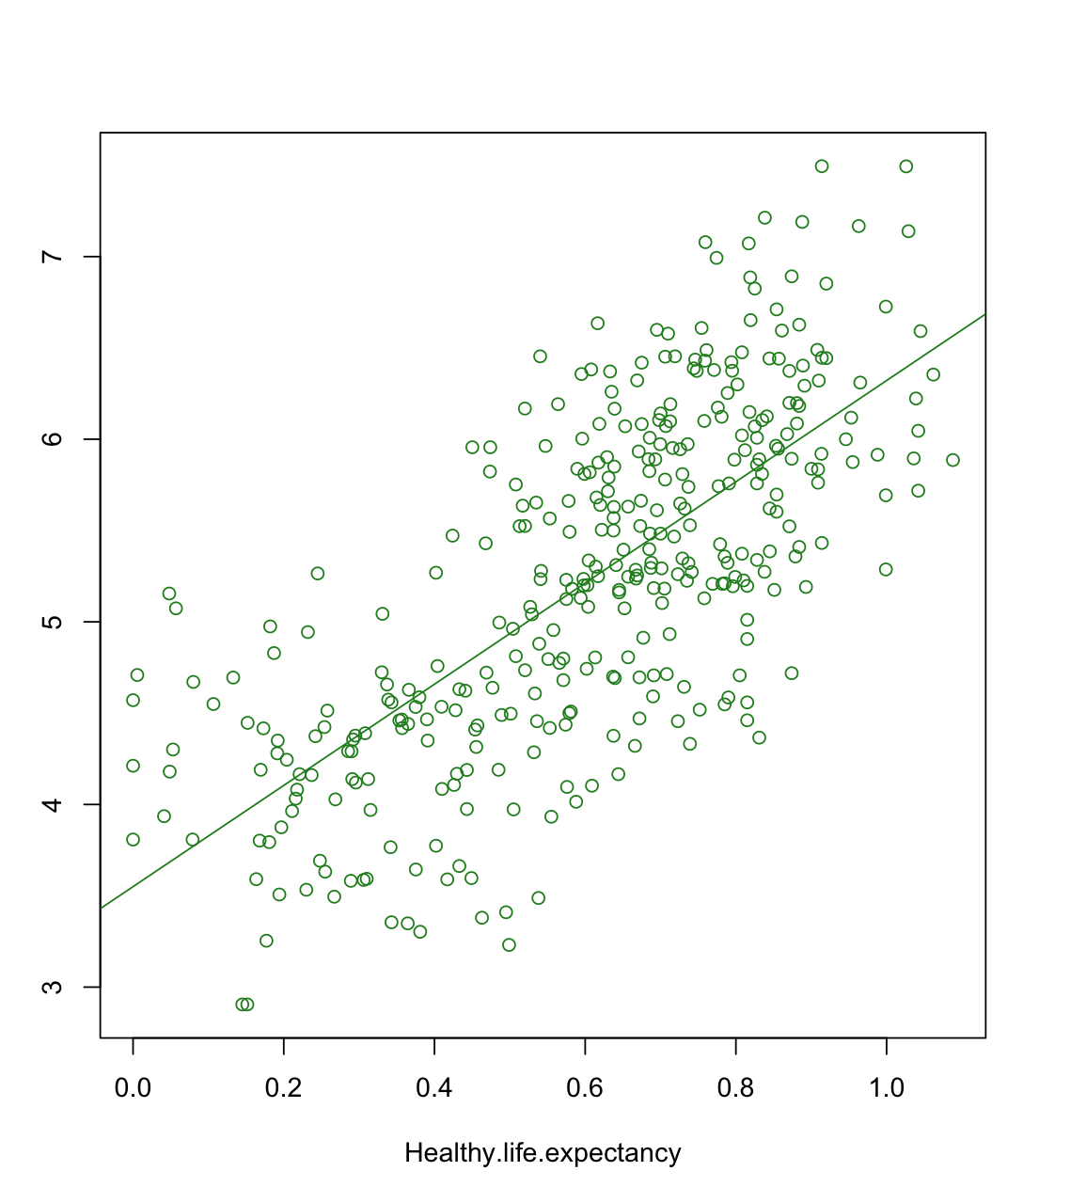
Relationship between Variables

Slide 6
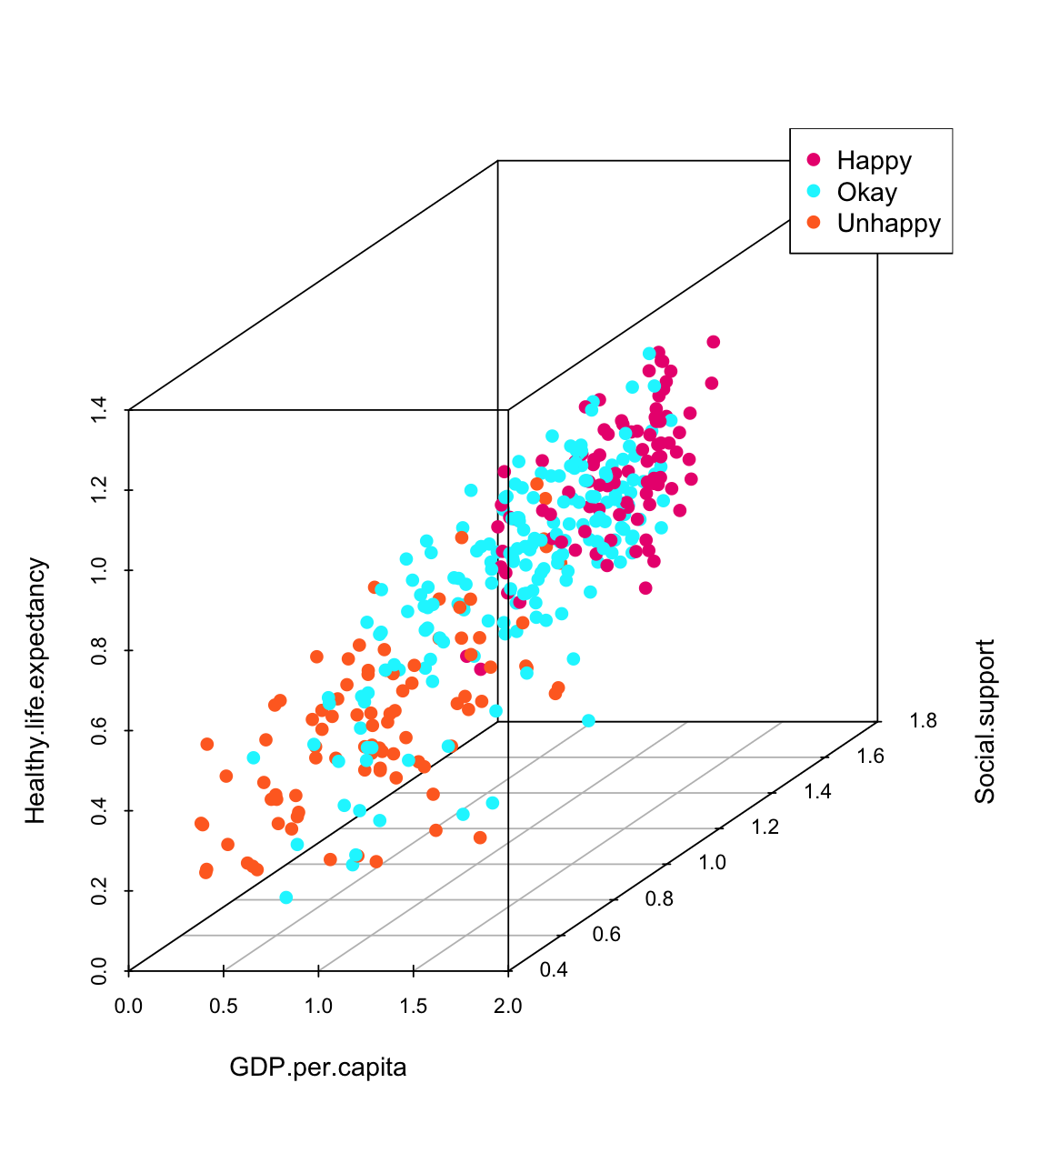
Variables and Happiness
The data is separated into three groups: Happy(3rd Q), Okay(between 3rd and 1st), and Unhappy(1st Q), based on the quartiles of the overall happiness score.

Slide 7

Do rich people donate more?

Slide 8
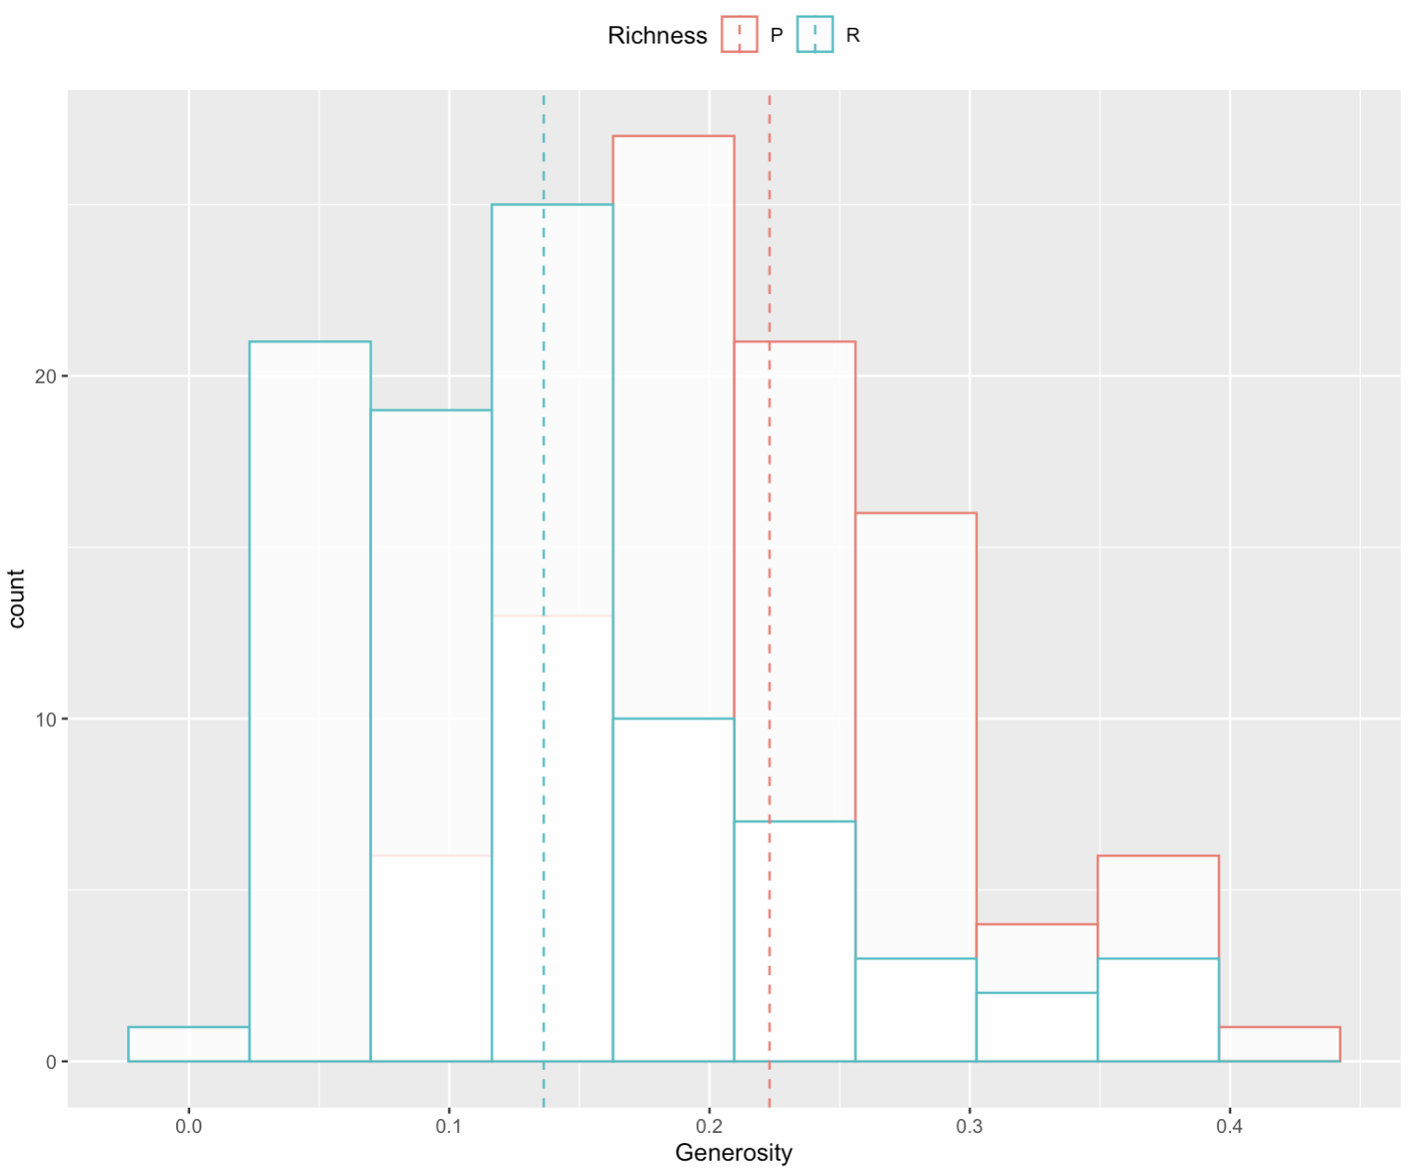
Wealth and Generosity

Slide 9

Reference
About | The World Happiness Report. (n.d.). Home | The World Happiness Report. Retrieved April 27, 2023, from https://worldhappiness.report/about/
FAQ | The World Happiness Report. (n.d.). Home | The World Happiness Report. Retrieved April 27, 2023, from https://worldhappiness.report/faq/
PhD, M. S. (2007, May 30). Healthy Life Expectancy and How It’s Calculated. Verywell Health; Verywell Health. https://www.verywellhealth.com/understanding-healthy-life-expectancy-2223919
The Investopedia Team. (2009, July 8). GDP Per Capita Defined: Applications and Highest Per Country. Investopedia; Investopedia. https://www.investopedia.com/terms/p/per-capita-gdp.asp

